Slide 1
WELCOME
Roadent ~ AI-Powered Road Emergency Assistant
Road Safety Hackathon 2026
CoERS, IIT Madras | RBG Labs
Theme: AI in Road Safety
Team: Raghav Malhotra, Siddharth Bajaj

Slide 2
EVERY SECOND COUNTS. MOST PEOPLE WASTE THEM.
In a road accident, the first 60 minutes are called the "Golden Hour" — timely medical help in this window can mean the difference between life and death.
The reality:
Victims and bystanders don't know the nearest hospital
Emergency numbers work, but locating the closest one doesn't
No single platform combines hospitals, police, ambulances, and towing by your live location
Low-network areas make online searches impossible
26,000+ road accident deaths annually in Delhi NCR alone.

Slide 3
ROADENT– TALK TO IT. IT FINDS HELP
Press SOS → nearest services appear in under 1 second
Speak your emergency — no typing required
Works with zero internet — offline SQLite database
AI assistant (Mistral) answers follow-up questions in natural language
Generates a shareable incident report instantly
Global coverage via OpenStreetMap — works anywhere in the world

Slide 4
HOW IT WORKS
User (Browser)
GPS location + message → FastAPI Backend → SQLite DB (900+ services)
FastAPI Backend → Mistral AI (natural language reply)
FastAPI Backend → OpenStreetMap Overpass API (global fallback)
All results → Map markers + Chat cards → back to User
Tech stack:
FastAPI · Python · SQLite · Mistral AI · Leaflet.js · Web Speech API · OpenStreetMap
Two-layer data strategy:
Layer 1 — Local SQLite DB with 900+ verified hospitals, police stations, ambulances across Rajasthan, Haryana, Delhi NCR. Works fully offline.
Layer 2 — OpenStreetMap Overpass API fallback for any location globally when local DB is sparse.
Offline mode: if Mistral or internet is unavailable, the local DB responds in under 300ms with no API calls at all.

Slide 5
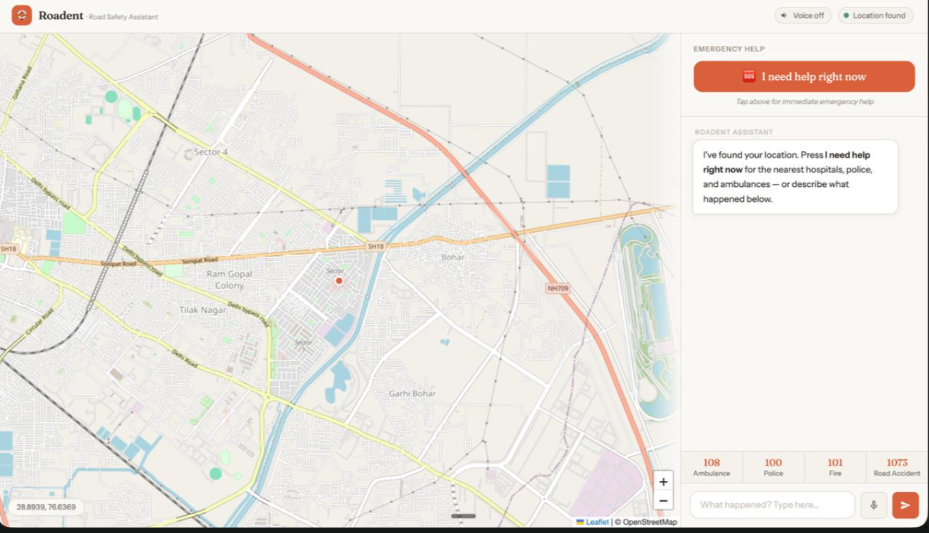
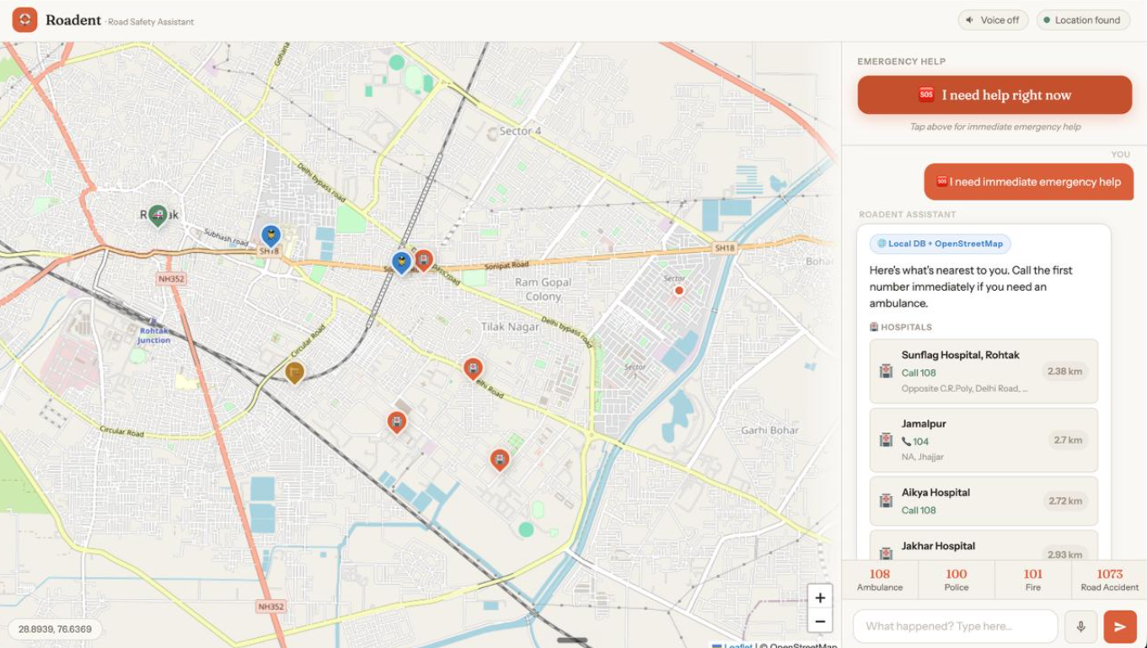
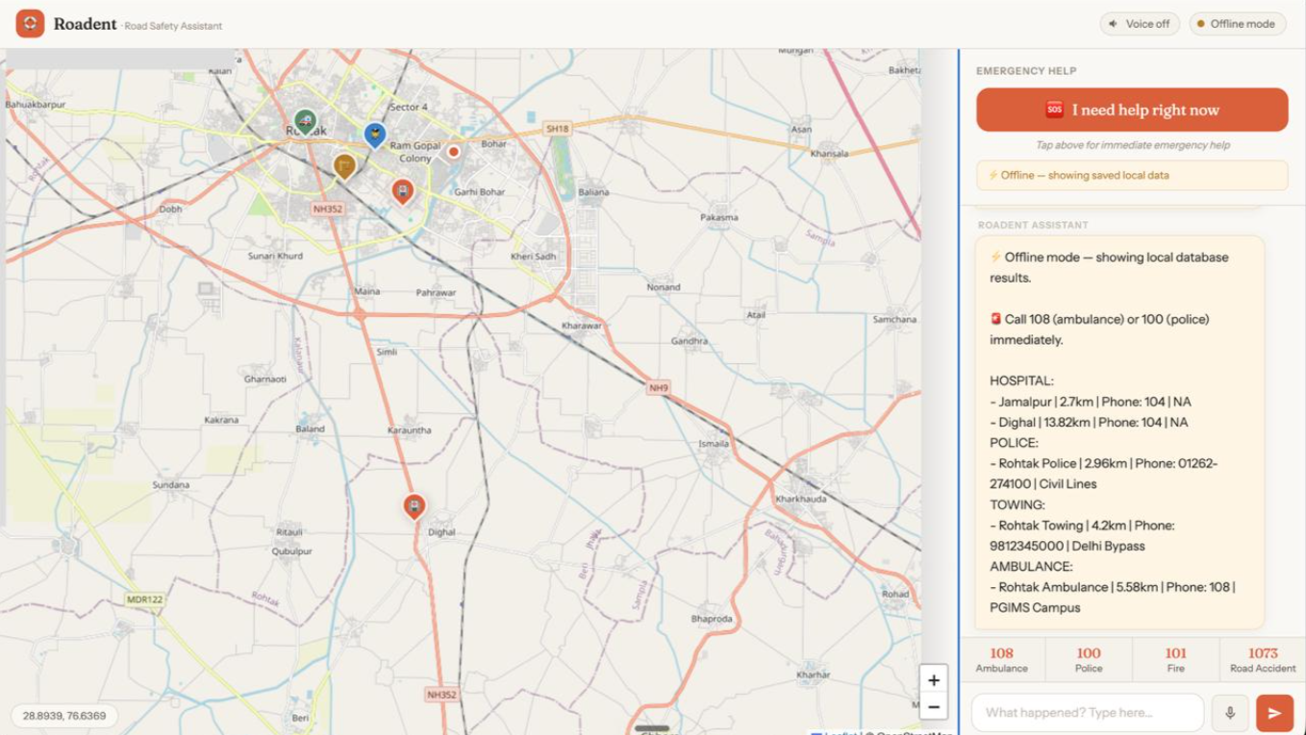
SEE IT IN ACTION
The UI: map centred on user location, SOS button, national helpline strip at the bottom (108 · 100 · 101 · 1073)
After pressing SOS: service cards showing nearest hospital, ambulance, police with distances and tap-to-call phone numbers, colour-coded map markers plotted
Voice mode active OR offline mode amber banner showing local DB results
Live demo: https://youtu.be/ase0gJIejrA?si=4he1JGSI4idwS8OI

Slide 6
HOW ROADENT MEETS EVERY CRITERION
Reliability and data accuracy
859 verified CHC and District hospitals from official government dataset, deduplicated by coordinate
Number of contacts fetched
Up to 5 hospitals + 3 police + 3 ambulances per query, all with tap-to-call phone numbers
Offline functionality
Full SQLite local database — core features work with zero internet connection
Innovation and additional features
Voice input and text-to-speech output, multi-turn AI chat, instant incident report generation
Global applicability
OpenStreetMap Overpass API fallback covers any country worldwide automatically
User interface and accessibility
Warm approachable design, large SOS button, voice mode for users who cannot type

Slide 7
THANK YOU
Live Demo: https://youtu.be/ase0gJIejrA?si=4he1JGSI4idwS8OI
GitHub: https://github.com/raghazzz/roadent.git
Team: Raghav Malhotra
Siddharth Bajaj
Road Safety Hackathon 2026 | CoERS, IIT Madras

